Slide 1


Current Topics in Biology
UCIL20882/92
Unit Coordinator: Dr Ruth Grady

Slide 2
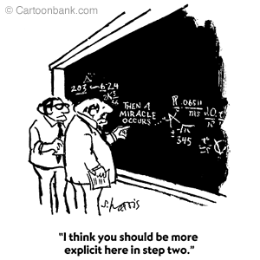
Intended Learning Outcomes: Students taking this unit will be able to
Describe and evaluate the basic science underpinning current topical issues in the biological sciences
Debate and defend informed opinions about current biology issues including their impact on society
Work collaboratively in an interdisciplinary team to investigate and present an aspect of bioscience research

Slide 3
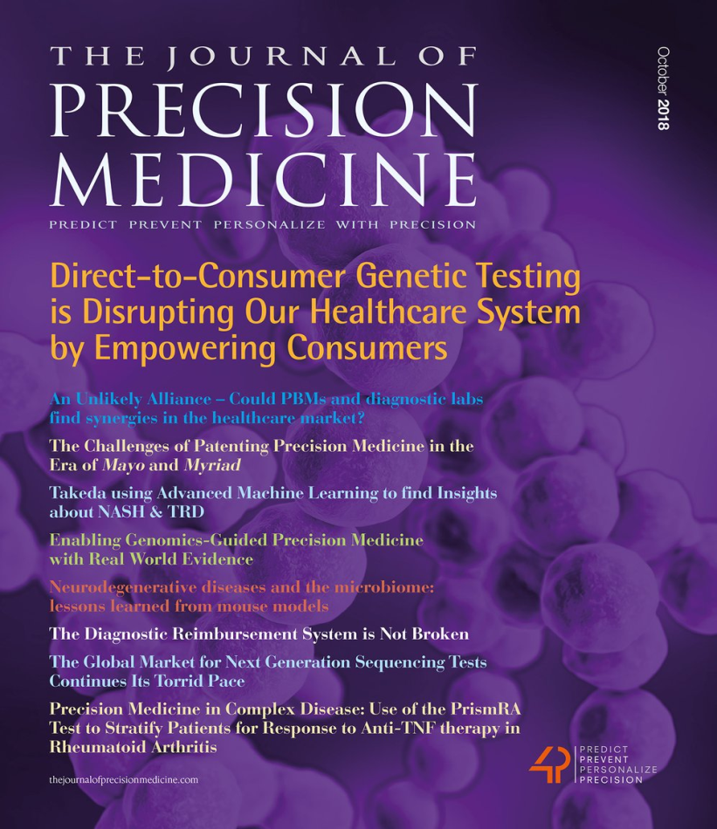
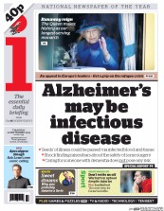
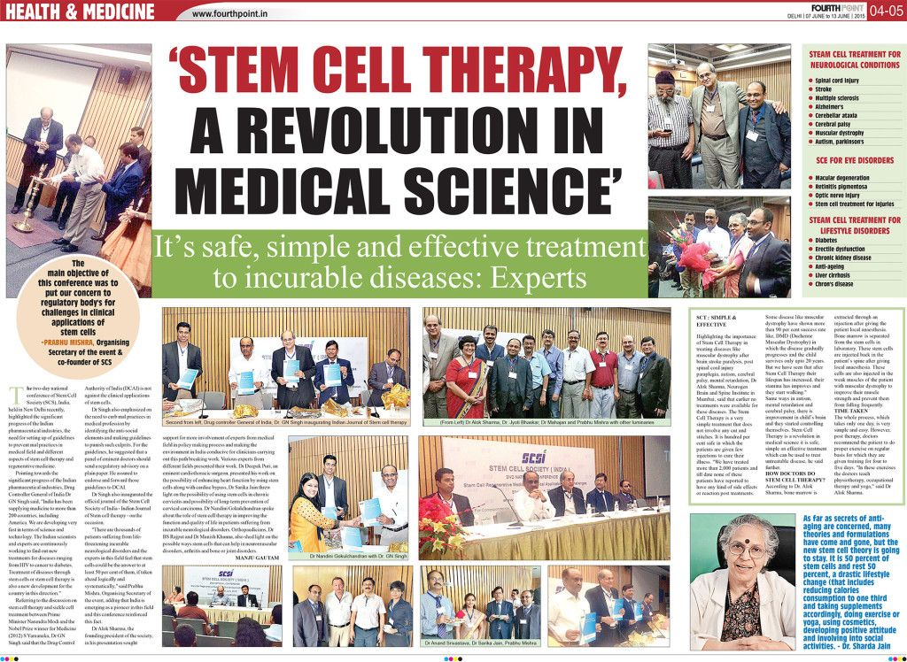

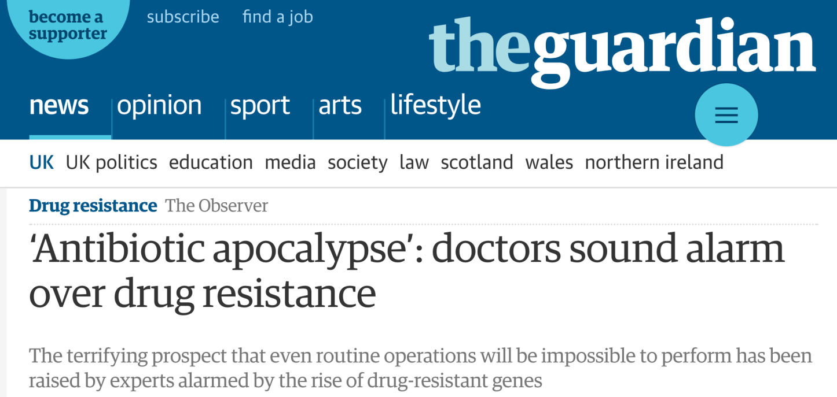
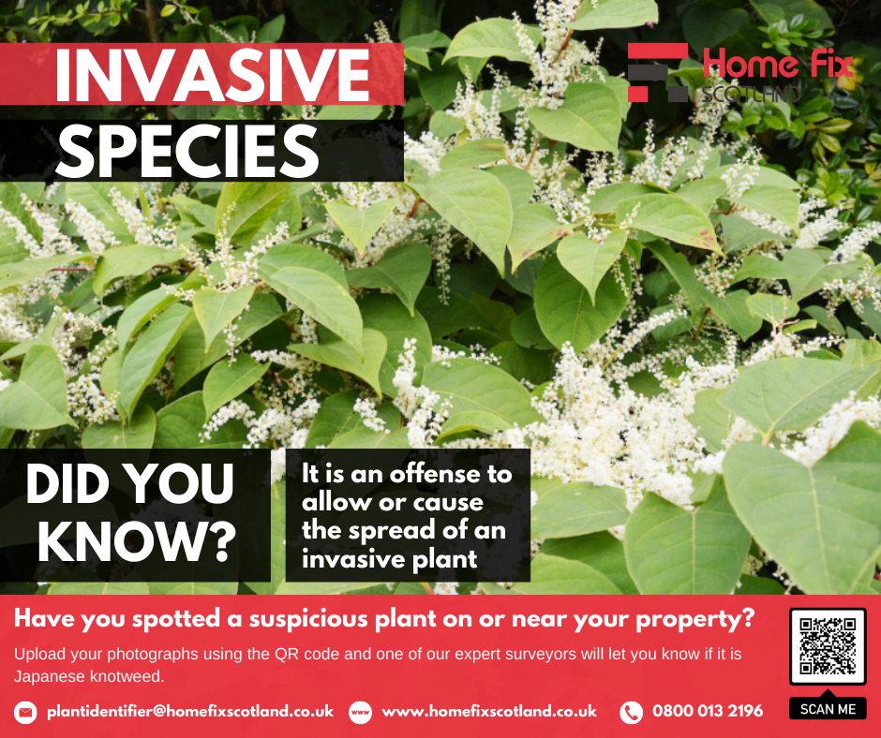
Content of unit
6 Biology Topics to showcase a selection of current & relevant biology

Slide 4
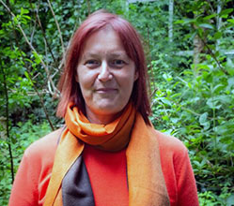
Topics 1 and 2
DNA
Development & Stem Cells
Dr Maggy Fostier
Senior lecturer (Genetics)
Maggy.Fostier@manchester.ac.uk
DNA – some basics
Beyond the Human Genome Project
How the fertilised egg becomes a fully formed adult body
Stem cells and what are their potential therapeutic uses
“What are the differences between embryonic and adult stem cells?”
“What stem cell therapies are showing clinical promise?”

Slide 5
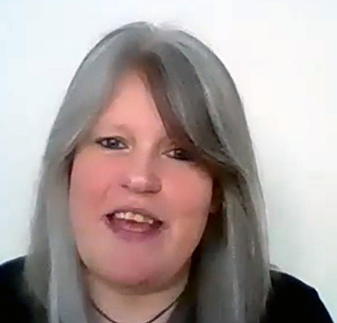
Topic 3
Precision Medicine
Dr Susan Cochran
Susan.cochran@manchester.ac.uk
Senior Lecturer (Pharmacology)
Introduction to the concept and controversies
Tailoring drug treatments for individuals
New technologies and platforms
“Why do some patients respond better than others to the same treatments?”
“What diseases/conditions are best targets for such new approaches?”

Slide 6
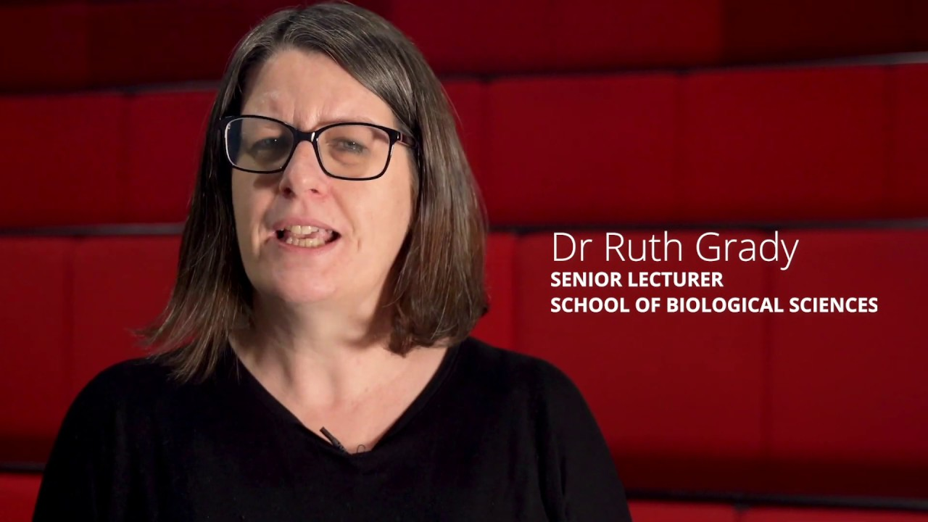
Topic 4 Microbes and Infectious Disease
Dr Ruth Grady
Ruth.grady@manchester.ac.uk
Senior Lecturer (Microbiology)
What issues are the most pressing for clinical microbiologists today?
Superbugs (MRSA), antibiotic resistance and the rise of sexually-transmitted diseases
Discussion based on a paper: gut bacteria and faecal transplants
“Why are we running out of antibiotics?”
“Are faecal transplants the future?”

Slide 7
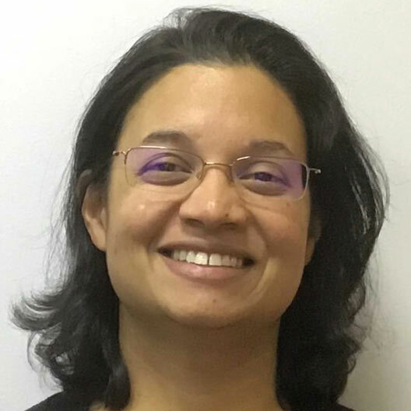
Topic 5 The Human Brain
Dr Bipasha Choudhury
Bipasha.Choudhury@manchester.ac.uk
Reader (Anatomical Sciences)
Anatomy of the brain?
Common neurological disorders – Alzheimer’s/Parkinson’s
Discussion: neurological disorders
“How do nerves work?”
“What happens in brain disorders?”

Slide 8
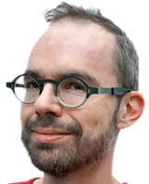
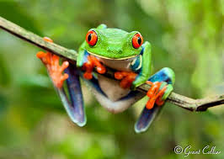
Topic 6 Conservation Biology
Dr Thomas Nuhse
Thomas.nuhse@manchester.ac.uk
Senior Lecturer (Plant Sciences)
What is biodiversity, can we protect it and why should we care?
“Should we worry about ‘alien’ species?”
“Why is biodiversity important?”
“What damage are non-native species causing?”

Slide 9
How will this course be delivered?
Each Topic is 3 sessions
2 x Lectures; 1 x discussion format
All will be delivered as live on campus
Lectures will be podcast
Coursework component (see later)
Blackboard presence – please look at it!
Lecture slides and videos available from Blackboard (and on video portal suite)
Discussion boards on Bb
Twitter account @UCIL20882 – will retweet interesting science stories

Slide 10
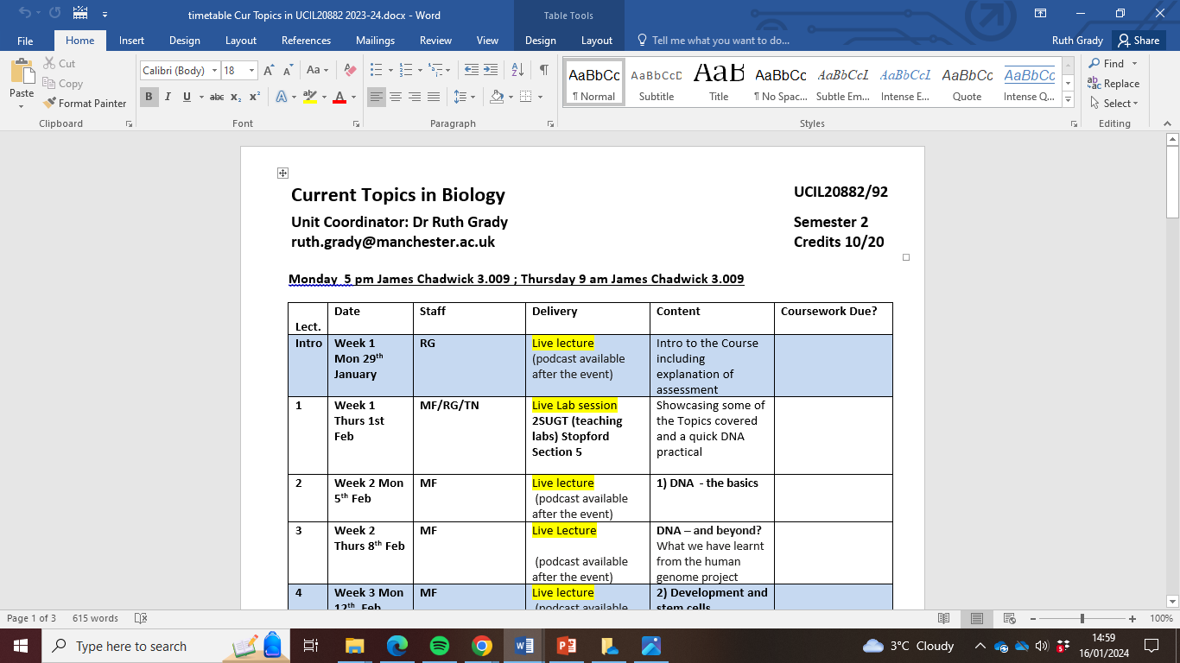
Timetable of lectures - front page of Bb & Course Information

Slide 11
How will this course be assessed?
10 credit UCIL20882
20 %: group video activity
40 %: individual coursework assignment: on 2 x chosen topics
40 %: final online written examination (SAQs)
20 credit UCIL20892
10 %: group video activity
70 %: individual coursework assignment: on 4 x chosen topics
20 %: final online written examination (SAQs)

Slide 12
Coursework
Full details on Blackboard
10 C UCIL20882: 2 pieces : choice of 2 types of coursework activity (from Topics 2-6)
20 C UCIL20892: 4 pieces : choice of 3 types of coursework activity (from Topics 2-6)
Submission deadline Week 11 (after Easter); Thursday May 2nd by 4 pm
Submitted & marked via Turnitin on Blackboard
Earlier submissions allowed so you can time manage your own workload
Formative exercise available
Suggested deadline Week 4;
Compare your work to work already marked to help with further coursework
Can ask for clarification during Dr Fostier’s lectures

Slide 13
One suggestion:
1. DNA
Coursework (formative practice only)
Type ’a’ only
2. Stem Cells
Type a
3. Precision Medicine
Coursework
10 Credit unit
4. Microbes
Coursework
5. Brain
Type b
6. Conservation
Choose 2 out of 5 topics for the coursework; can only submit either type 2 x ‘a’ OR 1 x type ‘a’ and 1 x type ‘b’

Slide 14
Another suggestion:
1. DNA
Coursework (formative practice only)
Type ’a’ only
2. Stem Cells
Coursework
3. Precision Medicine
Type a
10 Credit unit
4. Microbes
5. Brain
Type a
6. Conservation
Coursework
Choose 2 out of 5 topics for the coursework; can only submit either type 2 x ‘a’ OR 1 x type ‘a’ and 1 x type ‘b’

Slide 15
20 Credit unit
1. DNA
2. Stem Cells
6. Conservation
5. Brain
3. Precision Medicine
4. Microbes
Coursework
Type ‘a’
Coursework (formative practice only)
Coursework
Coursework
Coursework
Type ‘a’
Type ‘b’
Type ‘c’
Type ‘a’ only
One suggestion:
Choose 4 out of 5 topics to complete the coursework; can only submit 1 of type ‘b’ and 1 of type ‘c’; can all be type ‘a’ if you prefer

Slide 16
20 Credit unit
1. DNA
2. Stem Cells
6. Conservation
5. Brain
3. Precision Medicine
4. Microbes
Coursework
Type ‘b’
Coursework (formative practice only)
Coursework
Coursework
Type ‘a’
Type ‘a’
Type ‘a’ only
Coursework
Type ‘a’
Another suggestion:
Choose 4 out of 5 topics to complete the coursework; can only submit 1 of type ‘b’ and 1 of type ‘c’; can all be type ‘a’ if you prefer

Slide 17
Coursework (a)
Chose a newspaper /media headline/story from Social Media that is part of Topics 2-6
Write a lay summary (0.5 A4 page) and a technical summary (0.5 A4 page) explaining the story
Should be a clear difference in language (and tone) but content the same
No citations necessary
Using Google Scholar or PubMed, showcase 5 research papers linked to the bioscience Topic
Harvard citations and a brief summary (1/3 page) of the papers required
Can select the topic even if the lectures have not taken place yet!

Slide 18
Sample Coursework… (on Bb)
Summary statement explaining the link to Topic 4 ‘Microbes and infectious disease’. In this topic we covered the gut microbiota and its relationship with systemic health, and how diarrhoeal disease can be overcome using faecal transplants. The story presented below is about faecal transplants in Koala bears. The accompanying 5 references relate gut microbiota with different diseases or conditions.
Headline: Faecal transplants ‘could save endangered koala’ The Guardian, June 2023
Lay summary: The koala population has been drastically reduced in the last century through human urbanisation and destruction of the koalas’ natural habitat. Koalas survive by eating the leaves of the eucalyptus; there are two type of eucalyptus (messmate and manna-gum) and most koalas only eat one variety ………
Science summary: The koala (Phascolarctos cinereus) is an arboreal herbivorous marsupial native to Australia and is found in coastal areas of the mainland's eastern and southern regions. The koala population has been drastically reduced in the last century due to the habitat destruction caused by agriculture and urbanisation. Most of koalas’ diet consists of several Eucalyptus genera (Eucalyptus microcorys, E. tereticornis, and E. camaldulensi; …..
[May need to do some extra reading to fill in the science detail]

Slide 19
5 current references required
Paramsothy, S., Kamm, M.A., Kaakoush, N.O., Walsh, A.J., van den Bogaerde, J., Samuel, D., Leong, R.W., Connor, S., Ng, W., Paramsothy, R. and Xuan, W., 2020. Multi-donor intensive faecal microbiota transplantation for active ulcerative colitis: a randomised placebo-controlled trial. The Lancet, 389 (10075), pp.1218-1228.
Summary: The utility of faecal transplants for patients with C. difficile infections has previously been shown. This study now shows that using several faecal transplants from multi-donors is a promising treatment for patients with ulcerative colitis. It is not yet known which specific bacteria are associated with negative and positive outcomes, or what the molecular mechanisms are for the bacteria to be protective. In the future, being able to match donors and recipients could lead to a more personalised treatment for this inflammatory bowel condition

Slide 20
Notes about CW (a)
Use your own words (do not cut and paste the abstract)
These references need to be related to the Topic from the course, even if the article is on a different aspect. For instance I would not expect to see any cited references about koalas here!
Approx.1/3 page of A4 (200 words)
The references need to be up-to-date (non pre-2020)
Before submitting, check this assignment has the following headings:
Statement of where the references link to the chosen Topic
Headline from newspaper/ social media story; date
Lay abstract
Science abstract
5 current scientific references from different areas but related to the overall Topic with summaries (200 words/no more than 1/3 page each)

Slide 21
Topic e.g. Topic 2 Development and Stem Cells
News article e.g. UK man free from HIV after stem cell transplant
Reference 1
Reference 2
Reference 4
Reference 3
Reference 5
Would expect all 5 references to be about stem cells used therapeutically or if they are a particular type of stem cell, 5 articles about different aspects of these particular cells; NOT about HIV or transplants in general or other developmental aspects from Topic 2
References need to cover different content (so not three papers from the same lab)
References need to be research NOT a general commentary or a review or lecture material

Slide 22
Marking Scheme (/30)
Criteria: Lay/Science summaries (/10):
Communication of science
Use of language
Length
Criteria: Accompanying references (/20):
Quality of chosen references (from last 5 years)
Research papers
Applicability to topic
Correct citation
Summary of research papers (in your own words)
Use of English

Slide 23
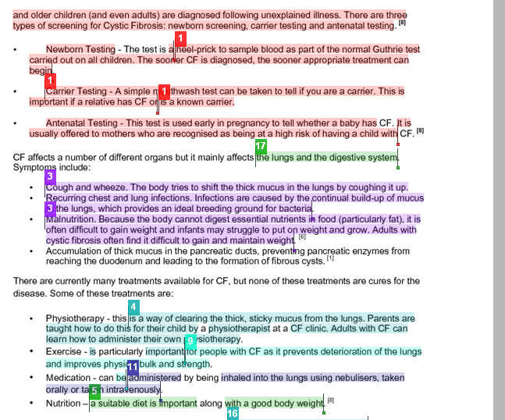
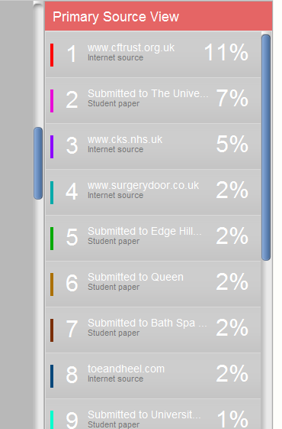
‘Turnitin’- Plagiarism detection

Slide 24
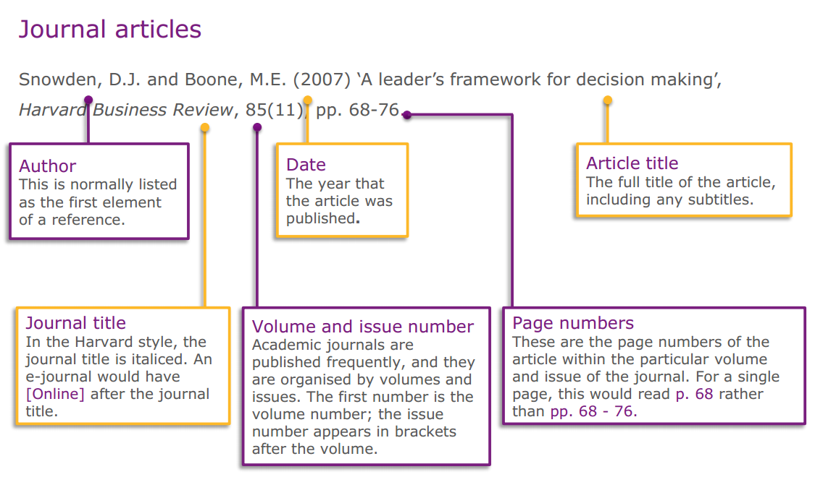
Citing science references
Refer to: My Learning Essentials guide to referencing

Slide 25
Coursework (b)
Write a 3-page essay highlighting the influence your degree programme/discipline has on, or is influenced by, or intersects with one of the biology Topics 2-6 offered in this course.
Chance to be inspired!
Mock example: Microbiology intersecting with BA (Hons) Basket-weaving with French

Slide 26
Notes about CW (b)
Before submitting: check this assignment (b) has the following:
Which Topic (2-6) is being linked to your degree programme
Describe your degree programme including references
Describe how the Topic intersects with your degree programme
Concluding paragraph
References

Slide 27
Marking scheme (b)
All criteria marked equally /30
Description of degree undertaken
Description of intersection with bioscience topic
Strength of argument
Range of chosen references
Correct citation of references
Overall length
Use of English

Slide 28
20C only: coursework (c)
Describe a concept or problem from one of the Topics that you found hard to understand
Write a short summary of the concept in lay terminology and what or why you found this difficult to understand
Create a learning resource/figure/analogy that helped you to get over this ‘bottleneck’ in your understanding that could be used to help other students. This could be in the form of a cartoon, mnemonic, diagram, poster etc. Describe the concept in technical language
Example: on Blackboard

Slide 29
Notes about CW (c) NB only for UCIL20892 students
Before submitting check this assignment (c) has the following:
Lay summary of the concept
Description of the problems you had to start with
Technical summary to show you now understand the concept
Show your learning resource/ tool for overcoming the concept barrier

Slide 30
Marking scheme (c)
All criteria marked equally /30
Lay description of concept
Description of difficulty
Description of learning tool: analogy/presentation/ mnemonic
Usefulness of output
Technical description of concept
Use of English

Slide 31
Combination of CW choices allowed
10C unit: chose either piece 2 x (a) OR 1 x (a) and 1 x (b)
20C unit: you can offer the following combinations of CW:
2 x (a); 1 x (b) and 1 x (c)
3 x (a); 1 x (b) or 1 x (c)
4 x (a)
Each piece from a different Topic (2-6)

Slide 32
Video Coursework
Work collaboratively in an interdisciplinary team to investigate and present an aspect of bioscience research
As a team produce a single 3 min video that presents a current biological research paper
Could use one of your papers you have found by completing the coursework
Can be in the same topic area as your individual coursework
Use a current Twitter story etc.
Will be put in groups by Week 7 (before Easter)
Will match Year Group (where possible)
ie all year 1 or final year etc
Communicate with each other via Blackboard or via email
After submitting you can peer review each other’s videos

Slide 33
Examination in May
90 min; in-person (online - PC Cluster)
Closed book
6 SAQS (short-answer questions) submitted on Blackboard
1 from each topic
Example questions (and answers) will be available on Blackboard during the semester
No past paper as content changes & reformatted course
Preparation for assessment session after Easter

Slide 34
Comment from previous students
This course was very interesting and gave a good introduction to biology. It was accessible for people like myself who don't have a background in biology and was very relevant to current topics in the news.
I found that content unbelievably interesting and even though each topic (out of 6) had only 2/3 lectures, each of the lectures were so interesting and I feel like they covered the perfect amount of detail.
I valued the diversity of this unit, I feel like I have learnt loads & all of it is topical & interesting. I would definitely recommend this unit.
I liked the fact that we had to do a group video, something I've never done before, that enabled the group to be more creative than just setting us an essay
I enjoyed the individual coursework assignment too as I had to approach it differently, it made a refreshing change from the standard essay assignments we normally get.

Slide 35
Feedback
Ask questions in the lectures & discussion sessions
Check your understanding
Use Bb to post questions on the Discussion Board
We encourage you to practice the coursework type (a)
By Week 4;
Based on Topic 1 (DNA and the Human Genome Project)
Will release feedback comments from sample answers to help with further CW
Have a go at the practice assessment questions to check your understanding

Slide 36
Spread the word: we can accept transfers to the unit up to the end of week 2

